Slide 1

Criteo Click Log Dataset
Team Members –
Somonnoy Banerjee
Niranjan Ambekar
Rakshitha Gade Rozario
Rahul Kengeri
Under the Guidance of –
Dr. Nidhi Rastogi

Slide 2
DATASET SEARCH
Searched for datasets on various topics on Google.
Got a lot of relevant datasets but data size restriction prohibited us from choosing those as our project dataset.
Got a dataset of 1 TB by Criteo AI Labs which revolves around the click-through rate.

Slide 3
DATASET SUMMARY
This dataset basically contains features and click feedback associated with millions of display ads.
The purpose of this dataset being made available was to benchmark algorithms in the domain of click-through rate prediction (CTR).
This dataset consists of 24 files which each corresponds to a day of data.
There are 13 features having Integer values and 26 features having categorical values.
One feature represents the target variable having values - 0 and 1.
0 represents advertisement was not clicked while 1 represents advertisement was clicked.

Slide 4
Importance of CTR
CTR basically helps us understand our customers.
CTR tells us that when reaching our target audience, what works and what does not.
We can market to our target customers for better conversions.

Slide 5
Main Analysis
Hypothesis: Whether a user would click the link of an advertisement or not.
We tried applying several models on the dataset like –
Logistic Regression
SVM Classifier
XGBoost
Random Forest
KNN
Naive Bayes
GD Boost
Ada Boost
Our choice of models encompasses the above models as all of them were suitable for the dataset that we have.

Slide 6
KNN
Somonnoy Banerjee
KNN classifies the new data points based on the similarity measure of the earlier stored data points.
For example, if we have a dataset of apples and bananas. KNN will store similar measures like shape
and color. When a new object comes it will check its similarity with the color (red or yellow) and shape.

Slide 7
Somonnoy Banerjee
SVM
As we know, SVM is a supervised machine learning algorithm which can be used for classification or regression problems.
It uses a technique called the kernel trick to transform your data and then based on these transformations
it finds an optimal boundary between the possible outputs. Simply put, it does some extremely complex data
transformations, then figures out how to separate your data based on the labels or outputs you've defined.

Slide 8
Comparison of different models
Model | Accuracy
Logistic Regression | 97.3%
Support Vector Machine | 97.33%
Random Forest | 97.33%
XGBoost | 97.33%
KNN | 97.06%
Naive Bayes | 93.53%
AdaBoost | 97.06%
GD Boost | 96.87%

Slide 9
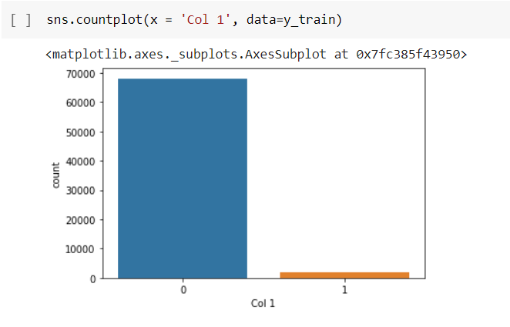
The problem of class imbalance

Slide 10
Methods used to tackle this problem
Oversampling
Undersampling
Synthetic Minority Oversampling Technique
Using F1-Score rather than just Accuracy as a performance measure
Using grid search for the classification threshold

Slide 11
Conclusion
SVM, Random Forest and XG Boost algorithm seem to work most efficiently with respect to accuracy.
The dataset is highly imbalanced towards the “not clicked” class.
Hence, getting a better precision was a challenge.
Oversampling method came to the rescue.

